Slide 1
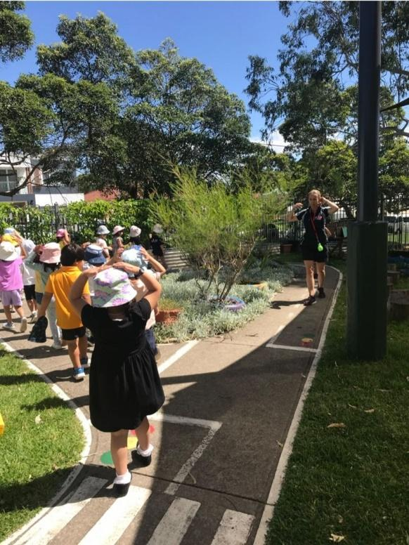
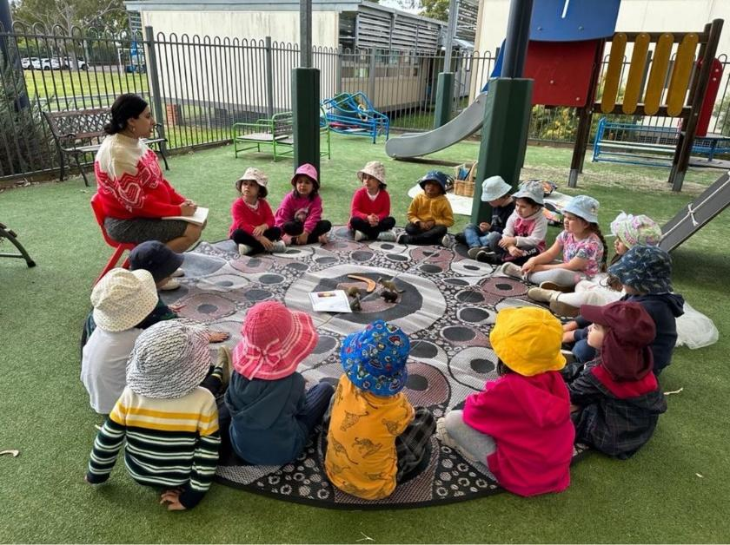
Welcome to Granville Public School Preschool.
Parent Information Book

Slide 2
Mission Statement
Granville Public School Preschool is a happy, safe, learning environment where we respect and engage with our diverse community helping to build foundations for the future.
Welcome to Granville Public School Preschool
This handbook contains information you require. Please do not hesitate to ask Educators if you need to know more.
School Principal: Mrs Anne Davies
Preschool Teachers: Mrs Sevda Karatas
School Learning Support Officer: Mrs Jannette Ayoub
Administration Officer: Ms Samantha Organ
You will find the following in here:
License and Rating
Management of our Service
Philosophy
Learning at Preschool
Daily Organisation
Daily Routine
What to wear and bring
Medical Conditions

Slide 3
Granville Public School Preschool
Address
Granville Public School Preschool
Florrie Street, Granville, 2121
Telephone: 9637 1083
Email: granville-p.school@det.nsw.edu.au
Website: www.granville-p.schools.nsw.gov.au
License and Rating
Our Preschool is a 40-place centre that offers a 5-day fortnight program, between 9:00am and 2:55pm daily, with a ratio of one adult for each ten children.
Approved provider: NSW Department of Education PR-00005345
Service number: SE-00007393
In September 2018 our Preschool was awarded a Meeting National Quality Standards rating through the assessment process via the Education Care and Quality Authority with an Exceeding rating in collaborative partnerships with family and community.

Slide 4
Management of our Service
Our service is operated by the Department of Education and is part of a Preschool to Year 6 Public School. Our School Principal is the:
Nominated Supervisor (Mrs Natalie See)
Educational Leader (Mrs Natalie See)
Responsible Person in Charge (Mrs Natalie See)
Our Preschool Teacher is responsible for the daily care and education of the preschool children in conjunction with an Educator.
For more information about our Policies and Procedures, please see the appropriate folder in our preschool foyer.

Slide 5
Children
We believe children are capable and resourceful learners, actively contributing to their own learning.
We believe children need to, and should be valued as individuals and are always growing in their identities, relationships, knowledge and understanding.
We believe children learn best when given opportunities to engage in meaningful play, encouraging dispositions for learning and allowing children to develop a range of skills and processes such as problem solving, inquiry, experimentation, hypothesising, researching and investigating.
Families
We acknowledge and believe that children belong first to a family.
We believe in working in partnerships with our families and strongly encourage family participation at all levels and times within the Preschool. We will also support our families with advice, encouragement and resources should they be required.
We believe family involvement is necessary within a quality program.
Program
We believe in providing an inclusive and high-quality developmental program in which every child feels welcome and valued.
We believe in play-based learning which allows children to actively and creatively engage with others and explore their environment.
We believe children need the encouragement to attempt new challenges and the opportunity to practise and consolidate their skills across all areas of development, working towards achieving the learning outcomes of the EYLF.
We believe cultural diversity should be embraced and children should be provided opportunities to acknowledge and celebrate the significant occasions and beliefs of both our families and the local community.
We believe in the value of exposing children to the natural environment and materials and acknowledge that children will explore these environments in a variety of ways.

Slide 6
Community
We believe it is essential to keep informed of the changes within our community.
We continue to reflect on and evaluate our program and relationships with the whole school and wider community.
We believe when needed, we are able to link the services of other professionals for families within our community. Therefore we have open lines of communication with the parent bodies, school executive, school staff and the larger school community.
We believe in the value gained from establishing relationships within the wider community and participate in whole school and the wider community events.
Educators
We foster a team approach where all educators are equally respected and valued to enable us to ensure service operations are consistently maintained and understood by all.
We believe staff help to create an environment of shared strengths and open communication, where family confidentially is respected and maintained.
We strive to provide a preschool experience shaped by trusting and nurturing reciprocal relationships with families, children, our broader school and geographic community.
We enjoy and value making lifelong connections and meaningful relationships with children, families, colleagues and our community.
Play based learning is our core focus at Granville Public School Preschool.
The education program is based on the interests of the children. We use learning stories, digital recordings, reflections and intentional teaching practices to formulate our teaching and learning cycle. Many activities and experiences are intentionally planned in order to build upon and extend skills and understandings.

Slide 7
The learning program is guided by the Early Years Learning Framework for Australia which is underpinned
by five Learning Outcomes for Children:
Children have a strong sense of identity.
Children are connected with and contribute to their world.
Children have a strong sense of wellbeing.
Children are confident and involved learners.
Children are effective communicators.
The education program is based on the interests of the children. We use learning stories, digital recordings, reflections, and intentional teaching practices
to formulate our teaching and learning cycle. Many activities and experiences are intentionally planned to build upon and extend skills and understandings.
The Preschool also participates in many of the whole school activities within the school, for example: Easter Hat Parade, Clean Up Australia Day,
Book Parade and NAIDOC week.
Our preschool also follows the Education and Care Services National Regulations as part of the National Quality Framework (NQF).

Slide 8
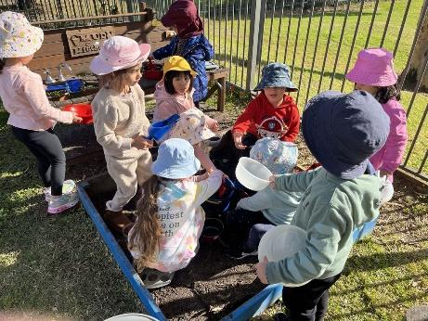
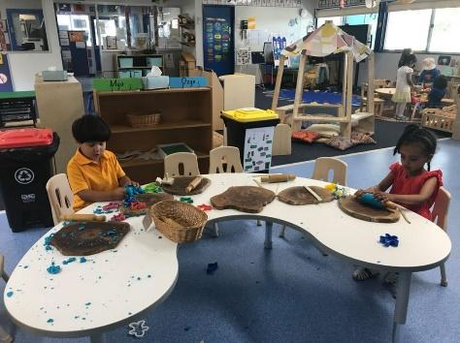
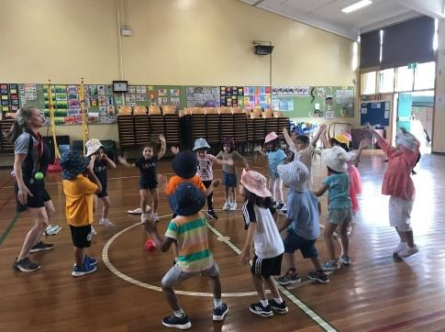
Information about the EYLF and NQF is available in the foyer in English and a wide variety of other languages.
Operation Times
9:00am – 2:45pm during school terms.
Our Preschool is a 40-place centre which offers a 5-day fortnight. Children enrolled at the preschool will attend either:
Koalas Week 1: Monday, Tuesday, and Wednesday.
Week 2: Monday and Tuesday
Possums Week 1: Thursday and Friday
Week 2: Wednesday, Thursday, and Friday
Attendance
Your child is expected to attend preschool every day unless sickness or essential appointments prevent this.
If your child is away for illness or holiday, please inform the preschool staff via phone or email.
Placements may be cancelled if a child is away for more than two weeks without notification to the school. Every effort will be made by our staff to contact a parent before a place is forfeited.
Our preschool follows the NSW Department of Education terms and school holidays.

Slide 9
Arrival and Departure
You will need to sign in and sign out your child every morning and afternoon. The signing in and out book is located in the foyer.
For safety reasons each child must be accompanied to and from preschool by their parent or another authorised person over 18 years of age. You will be asked to complete a form providing the names and phone numbers of the authorised adults you have consented to collecting your child. If someone arrives to collect your child and their name is not on our records of authorised adults, we cannot allow your child to leave with them.
If you unexpectedly require someone not on your list of authorised adults to collect your child, please phone the preschool to provide the name and phone number of the adult. The person’s name will be recorded on the arrival and departure register and the person will be required to show photo ID (e.g. driver’s licence) before collecting your child.
If you are running late due to exceptional circumstances, please alert the preschool as soon as possible.

Slide 10
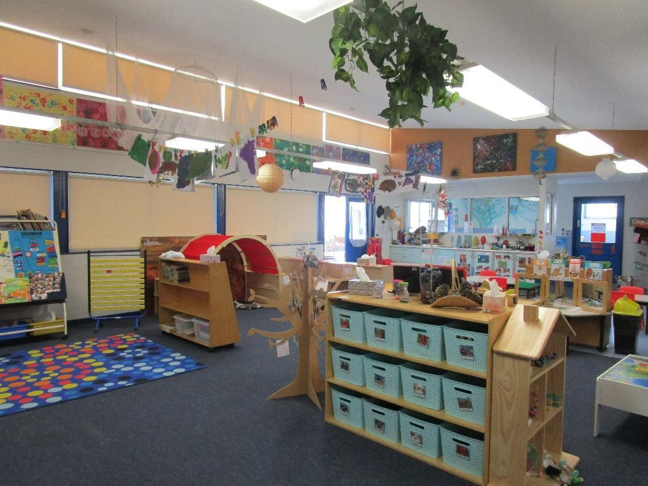
The daily routine allows for long uninterrupted periods of play for children to explore, discover, create, and imagine. Planned large and small group sessions occur during the day and are rich in literacy, mathematics, social skills and music and movement activities. Play is an essential part of a child’s learning.
9:00am Children arrive, place belongings in own locker.
Morning group time
9:30am Indoor and Outdoor play
10:45am Teacher led Group time.
11:15am Lunch
11:45am Music / Sport / Library
12:30pm Outdoor play
1:00pm Teacher led Group time (music/stories/circle games/yoga)
1:15pm Afternoon Tea
1:45pm Indoor play
2:45pm Preschool finishes
Our daily routine is flexible and may change in response to children’s interest, weather or special events.

Slide 11
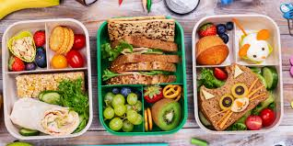
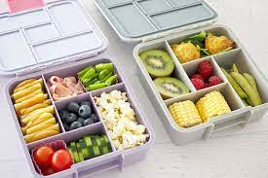
All children should have an age-appropriately sized bag/back-pack that can fit your child’s healthy lunch box, water bottle and a seasonal change of clothes.
Clothing
Please dress your child in comfortable, easily washed play clothes which allow for self-dressing. Clothes should be easy fitting – avoid overalls or pants with belts so that your child can be comfortable and independent in toileting.
Ensure that your child can put his/her shoes and fasten them – Velcro is ideal.
As we are involved daily with paint, sand and water and as toilet accidents are not uncommon at this age, we ask that you provide a spare set of clothing.
No thongs, crocs or slip in shoes please! As well, no shoulder straps on shirts or dresses.
Please make sure your child’s name is clearly marked on ALL their clothing and belongings.
Please provide a sun hat with your child’s name clearly marked. Hats should have a wide brim or be legionnaire style. No caps please. The hat will remain at the Preschool.
Healthy Lunch and snack
Our preschool promotes good nutritional habits for children and staff. We discourage any junk foods and packaged items such as chips, sweets, chocolates, lollies, flavoured milk or sweetened drinks, etc.
We recommend that you place an ice pack in your child’s lunch box to keep food at a safe eating temperature.
We are unable to heat food up for children.
To support and minimise any risk to children with anaphylaxis or allergies, we request that families refrain from sending any peanut related foods, including Nutella.
Drink bottle: Filled with WATER ONLY. Clearly labelled with name. Please do not send cordial, fruit juice in a bottle or in a fruit box.

Slide 12
Illness
Please do not send sick children to preschool. Sick children often become distressed when away from home and a sick child may infect others.
Children with any infectious conditions, including gastroenteritis, diarrhoea, vomiting, etc. must stay at home for at least 24 hours. Clearance from a doctor may be required before a child resumes preschool.
If your child has an infectious illness (e.g. measles, whooping cough, COVID-19, etc.), please notify the preschool immediately.
Supervision occurs at all times at preschool, but accidents may still occur. First aid and comfort will be given to your child by a staff member. Details of all accidents are recorded, and parents will be asked to sign the form upon collection of the child.
In the event of a serious accident or if your child becomes sick during the preschool day, you will be notified to collect your child.
Immunisation
The Department of Health asks that all children be immunised. A copy of your child’s immunisation history statement will be required prior to enrolment in the Preschool. If your child is not immunised, they cannot be included in our program.
Medication
If your child is required to take any prescribed medication during preschool hours, the medication must be given to the preschool teacher in its original packaging with the directions of use. You will need to sign a consent form detailing the medication, dosage and method of administration that gives permission for the medication to be administered by the preschool staff.
We are not permitted to give children any non-prescribed medication such as Panadol, Nurofen, cough medicine, etc.
Allergies
You must inform the Preschool if your child is allergic to any foods or is at risk of anaphylaxis. In order to provide a safe environment, all parents are reminded not to send any food that contains nuts. An ACTION PLAN signed by a doctor must be provided before your child can attend preschool. There are other forms required by the preschool and the Preschool Teacher will liaise with you about them.
Asthma
If your child suffers from any form of Asthma, the Preschool MUST be provided with an ASTHMA PLAN signed by a doctor before your child can attend preschool. Medications are also required to be kept at preschool.

Slide 13
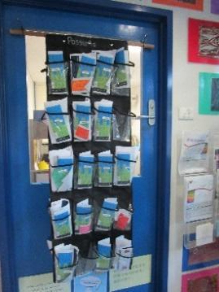
Communication
Each child’s name is on a ‘Communication Pocket” situated on a door in the foyer. This is where any notes or information will be placed.
It is important that you check this regularly.
We utilise Seesaw to capture and reflect on aspects of your child’s learning. This includes sharing your child’s learning though photos and videos.
Concerns or Complaints
Should you have any specific concerns regarding your child, please make an appointment with the teacher for an interview.
Complaints will be dealt with confidentially, fairly, and promptly in accordance with the NSW Department of Education’s
Complaints Handling Policy and Procedures.
The following is offered as the first point of contact regarding areas of compliment or complaint:
Child’s progress, learning, development and wellbeing – Preschool teacher
Preschool Organisation – Preschool Teacher
General Enquiries (school contributions– Preschool Administration Officer
Child Protection/misconduct issues – Preschool teacher / Principal
To lodge a complaint higher than the school principal, contact the Early Childhood Education Directorate (ECED).
Complaints for the breach of regulations are to be made to the regulatory authority Quality Assurance and Regulatory Services (QARS),
NSW Department of Education - Phone: 1800619 113.

Slide 14
Custody
The Preschool is to be advised in writing of any custody or alternate living arrangements and copies of legal documents are to be provided. Should there be alterations to these arrangements at any time, the Preschool should be informed immediately.
Parent Involvement
At Granville Public School Preschool, recognise that parents are the experts when it comes to knowing their children and their likes and interests. Sharing, communicating, and participating in the preschool program creates a valued partnership between families and the preschool staff.
If you have a special interest, play a musical instrument, or would like to read a children’s story in your home language, please come and speak to the Preschool educators – we would love to have your input.
Throughout the year we organise excursions and need the support of families to help on these occasions.
Each term we organise a “Do Drop In Morning” when we invite our families to spend some time in their child’s preschool.

Slide 15
Sunscreen
We are a “Sun Smart” preschool. You may wish to apply sunscreen before coming to preschool. Sunscreen will be applied at preschool at arrival times during the months of February through to May and then again September to December.
Sunscreen is available for reapplication throughout the day if needed.
Rest Time
Preschool does not enforce a scheduled rest time; however, Stretcher beds are available for children who require or request a sleep.
Quiet areas are available throughout the day – both indoors and outdoors for children to rest or relax in.
Rainy Days
Outdoor learning continues rainy days. We encourage children to bring their raincoats and boots to explore in the outdoor environment.
Library
The children will be going to the school library once a fortnight. Your child will borrow one library book which is to be returned the following fortnight.
A library bag (non-plastic) will be needed to protect their book. Please note that books must be returned before a new one can be borrowed.
Any books which are damaged or lost will need to be paid for so a replacement book can be purchased.

Slide 16
Before starting we recommend talking to your child about going to Preschool and find ways to promote Preschool as an exciting place where fun and learning will be enjoyed. This will help your child settle in.
Make sure your child knows:
how to use and flush the toilet
that hands should be washed after going to the toilet and before eating.
how to blow their nose
Encourage your child to become more independent by:
teaching your child how to take off and put on shoes and socks.
encouraging your child to dress and undress themselves.
encouraging your child to put away belongings and toys after use.
leaving your child with a relative or friend for short periods so that they are used to being away from you.
Prior to starting preschool, please inform the staff of any medical conditions, allergies or any other additional needs. All children need to be toilet trained before they commence preschool.
First Day
All children will all be provided with a name tag.
Stay for a few minutes while your child settles into an activity.
Even though you’ll feel upset while he/she is crying, the best thing to do is give your child a hug goodbye and leave. We advise against ‘sneaking out’ as this can be very distressing to the child who may feel abandoned.
If you feel you may have trouble saying goodbye, please let one of our Educators help with this.
We look forward to developing a positive relationship with you and your child.

